Slide 1
Final Project Linear Regression
Eric Shin
Jiahui Zhu
Yingqi Yuan

Slide 2

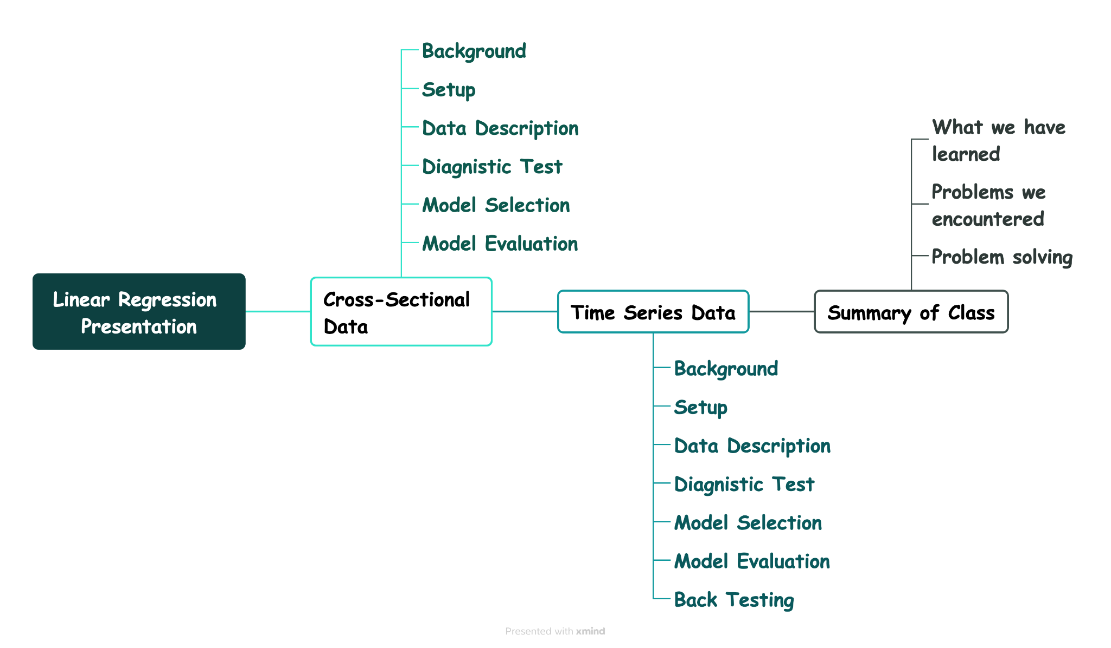

Presentation Outline
Notes:
Hi everyone, We kick things off by introducing our presentation outline,
We start by cross sectional analysis, in which we will go through the background and research setup, EDA ( exploratory data analysis) and then divide into diagnostic test and final model selection and evaluation.
After that we would continue to take about time series analysis, and the procedure is similar to that of cross sectional analysis expect for the back testing in the end.
And at the end of this presentation, we would give a brief summary of what we learned, problem that we encountered, and what we do to solve then.

Slide 3



Cross Sectional Analysis
Part 1

Slide 4
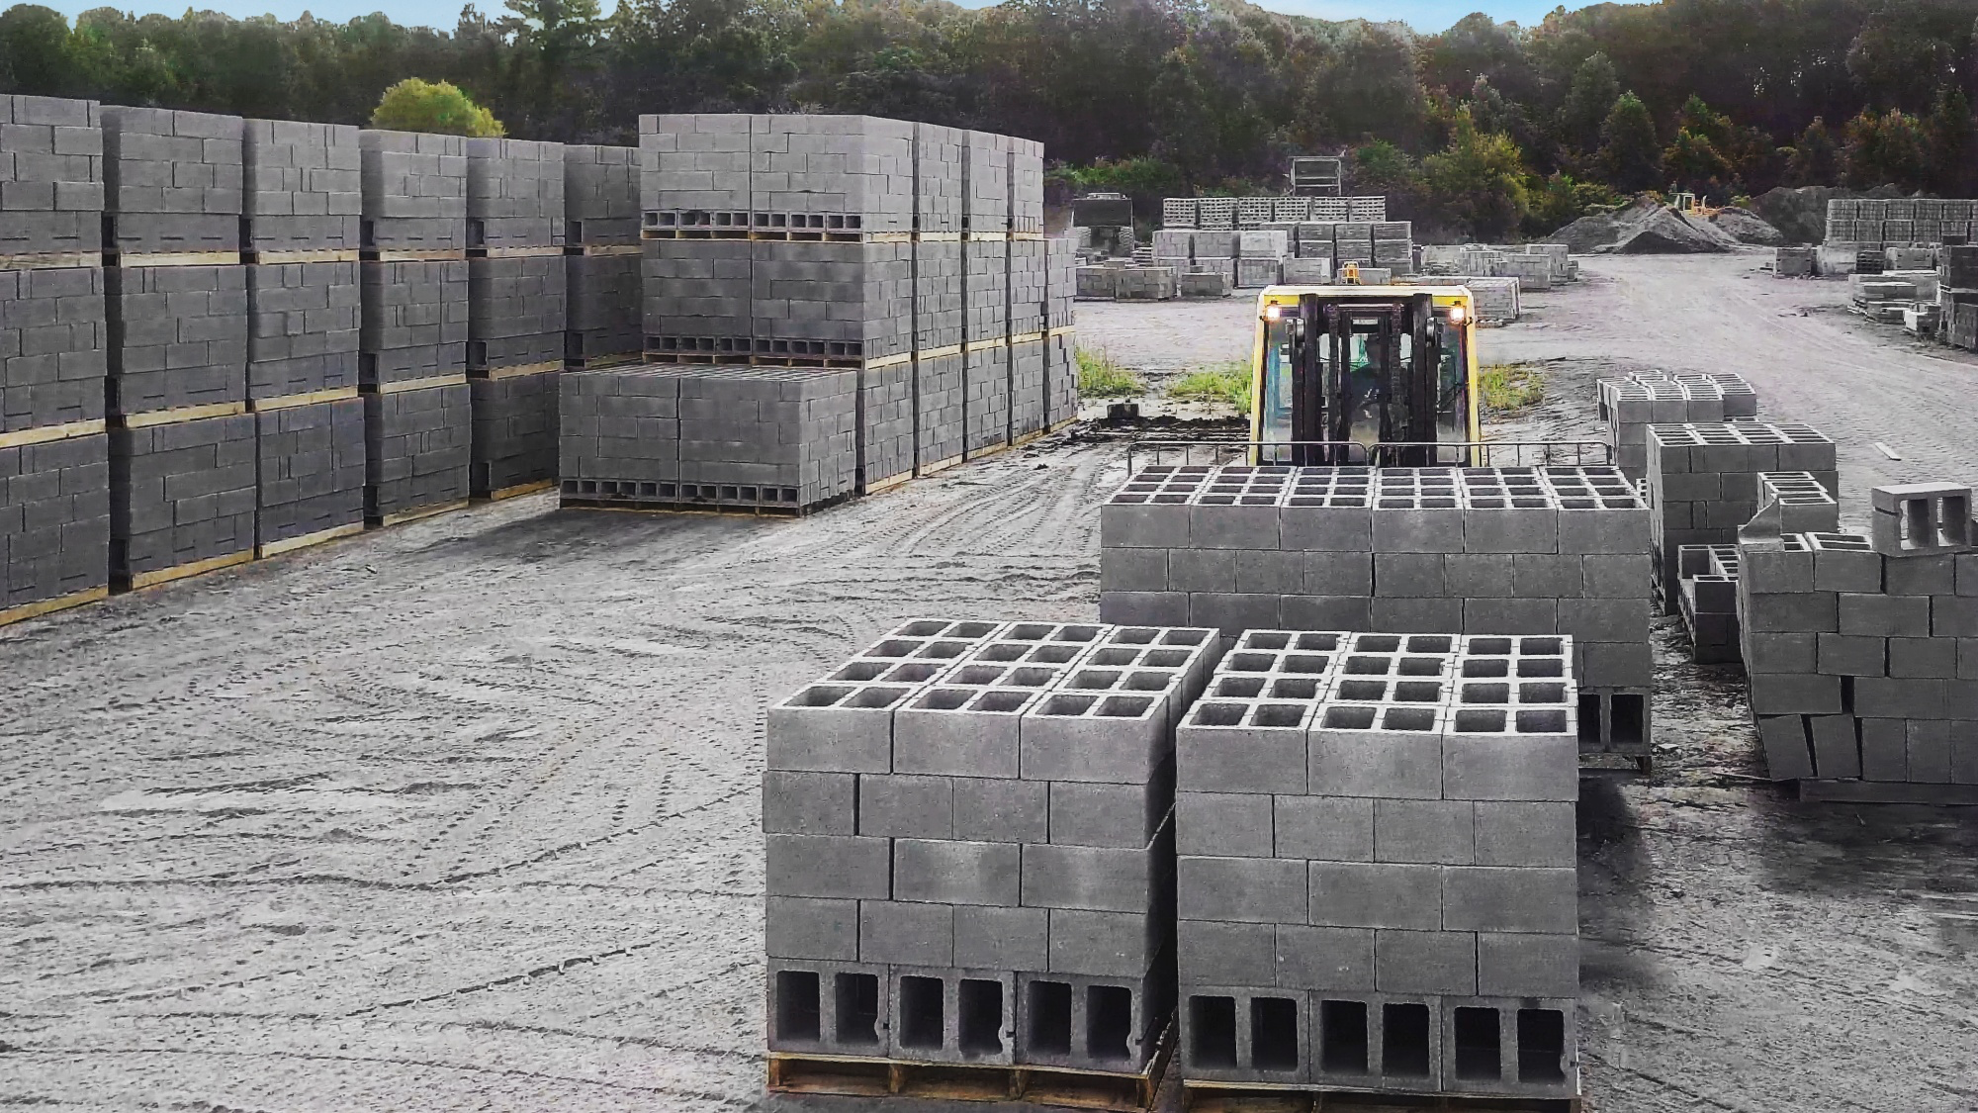
Cross Sectional Analysis: Background
Concrete is of paramount importance in modern construction due to its versatility, durability, and widespread application in infrastructure projects worldwide.
Notes:
We 'd like to discuss a topic that might initially seem unusual, yet it's intimately connected to our everyday lives. We're diving into the world of concrete—yes, concrete! While it might not be the first thing you think about when you wake up, it's actually a fundamental element in modern construction that shapes the environments we live and work in. Our focus will be on performing a cross-sectional analysis of concrete, exploring various factors affects concrete compressive strength.

Slide 5
Cross Sectional Analysis: Setup
Things that we want to figure out through data analysis…
Independent Variables:
Cement (kg in a m^3 mixture)
Blast Furnace Slag (kg in a m^3 mixture)
Fly Ash (kg in a m^3 mixture)
Water (kg in a m^3 mixture)
Coarse Aggregate (kg in a m^3 mixture)
Superplasticizer (kg in a m^3 mixture)
Fine Aggregate (kg in a m^3 mixture)
Age (day)
Dependent Variable:
Concrete compressive strength (MPa, megapascals)
Which factors influence the concrete compressive strength?
Notes:
Initially we select 8 variables as our independent variable, and you will see variable selection process in the upcoming analysis, which leaves us with 5 independent variables highlighted black here.And our goal in today’s analysis is to find out which factor influences the concrete compressive strength most.

Slide 6



Cross Sectional Analysis: Outline
01
02
Exploratory Data Analysis
Diagnostic Tests
Numerical Distribution, Outlier detection, linearity check, Standardization
Multicollinearity, Outliers, Linearity, Normality, Autocorrelation, Homoscedasticity,
03
Model Selection & Evaluation
Notes:
Cross sectional analysis is separated into three parts, the first part we will do EDA and go through the numerical distributed, outlier detection, linearity checks to give a better understanding of data, discover patterns or potential anomalies.
Then we go into detailed diagnostic tests about BLUE assumptions and give possible suggestions to fix those issue if it is not satisfied. Finally we would do model selection and evaluation.

Slide 7
Exploratory Data Analysis
01

Slide 8
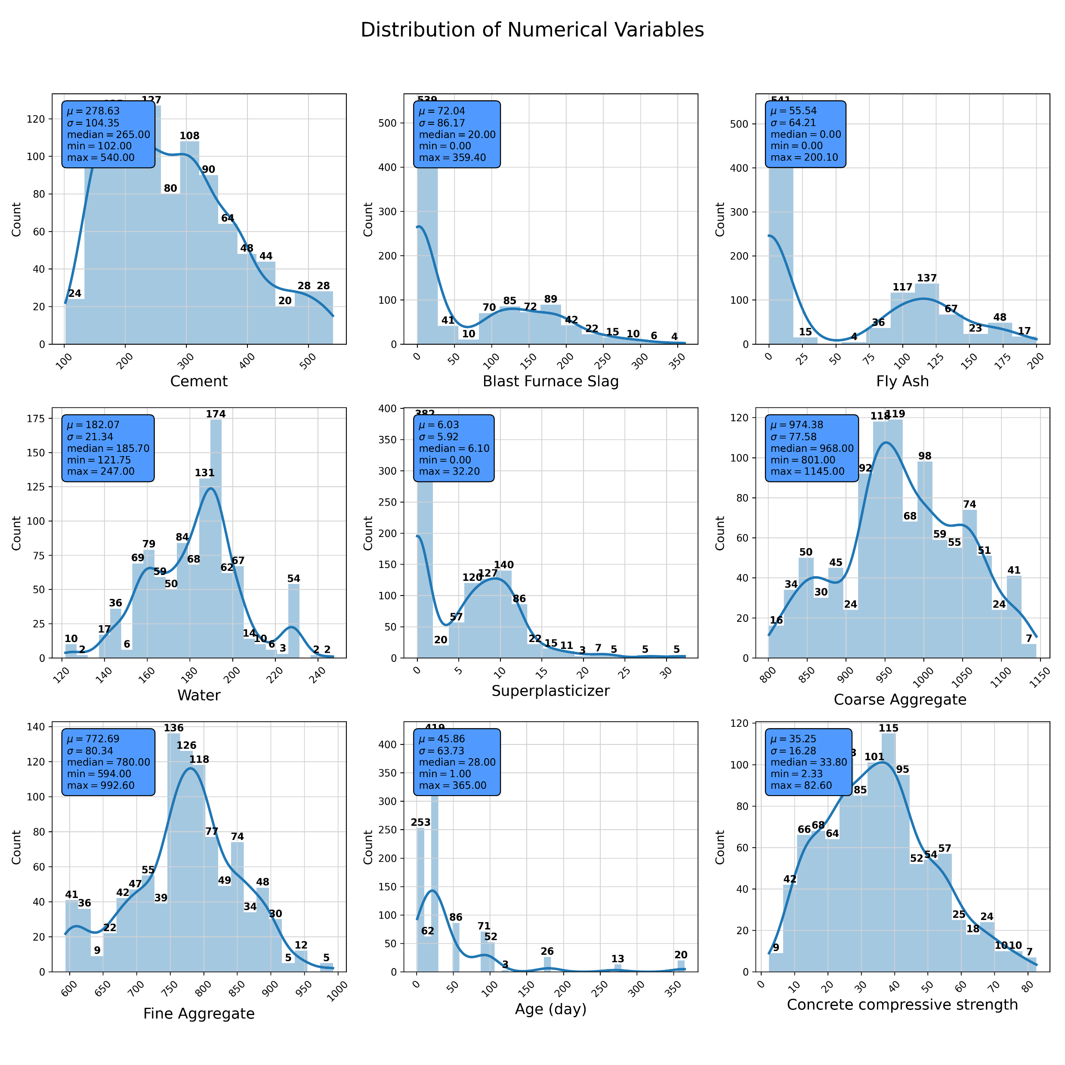
Get a feel for Data Distributions
* Variable Age is discrete in a sense that it may not be helpful in linear regression analysis, thus we may consider to drop it

Slide 9
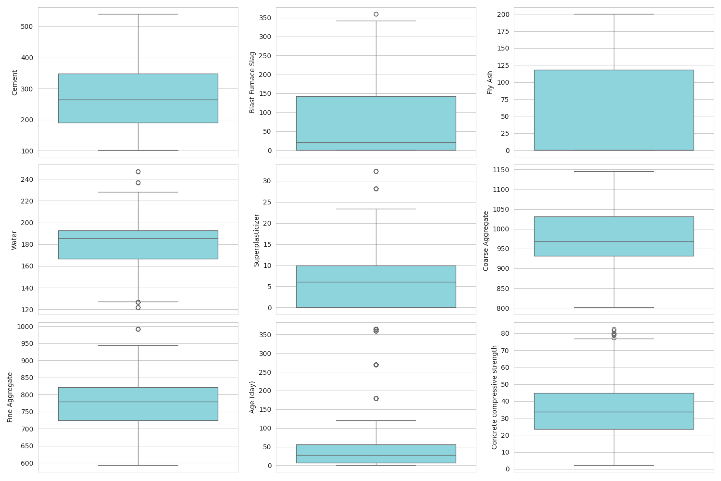
Identify Potential Outliers using Boxplot
There are some potential outliers highlighted in the graph that can be considered to remove in further analysis

Slide 10
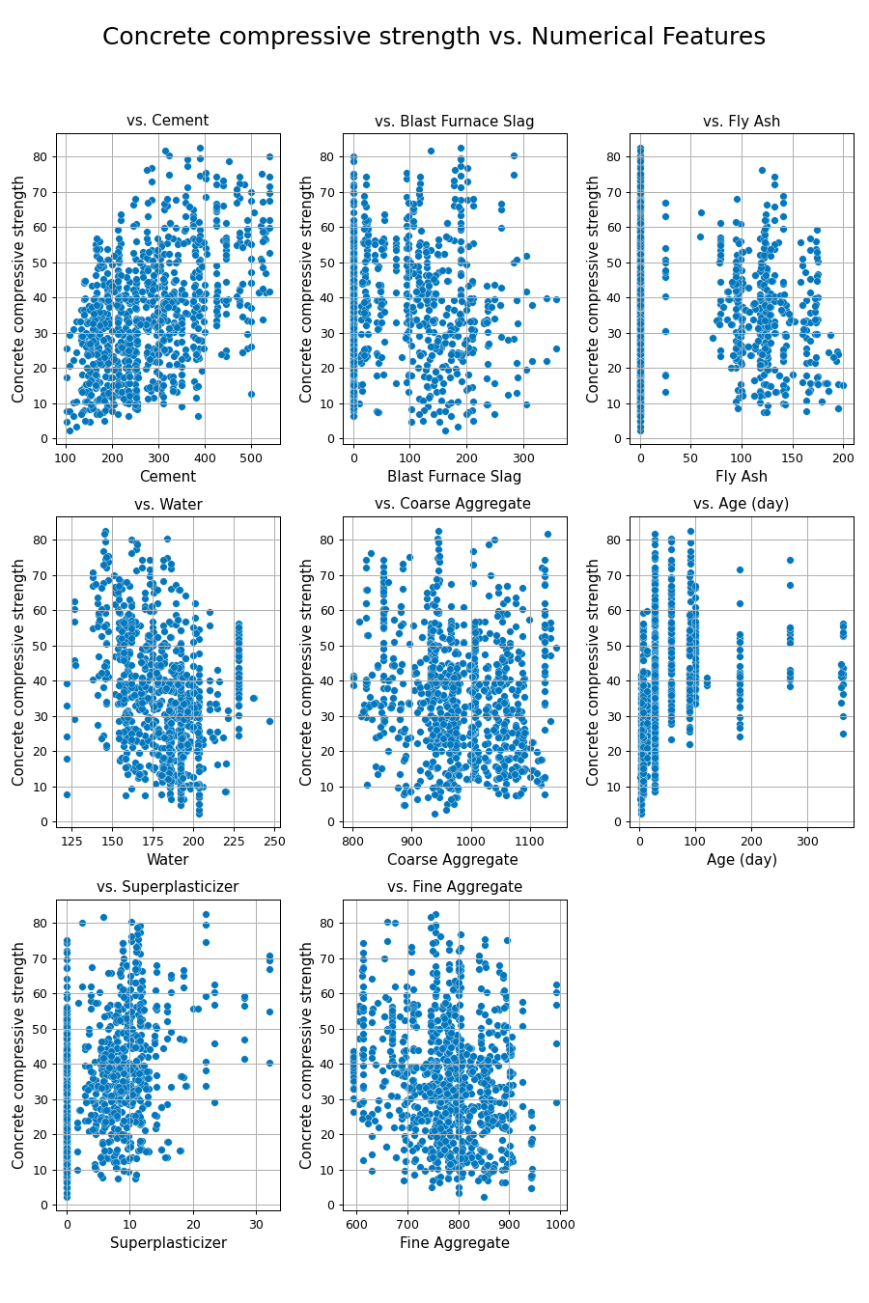
Check for Linearity between variables using Scatter plot
The relationship between cement and dependent variable seems to have a positive trend
The remaining plots show a lot of dispersion and do not display a clear linear trend, which makes it difficult to assess linearity just from the scatter plot.
Further analysis and tests needed!

Slide 11

Diagnostic tests
02

Slide 12
1. Multicollinearity
2. Outlier Handling
3. Linearity
4. Homoscedasticity
5. Autocorrelation
6. Normality

Slide 13
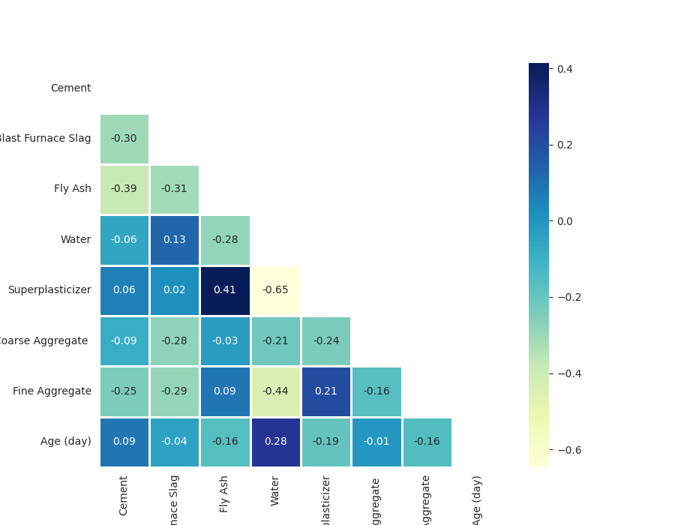
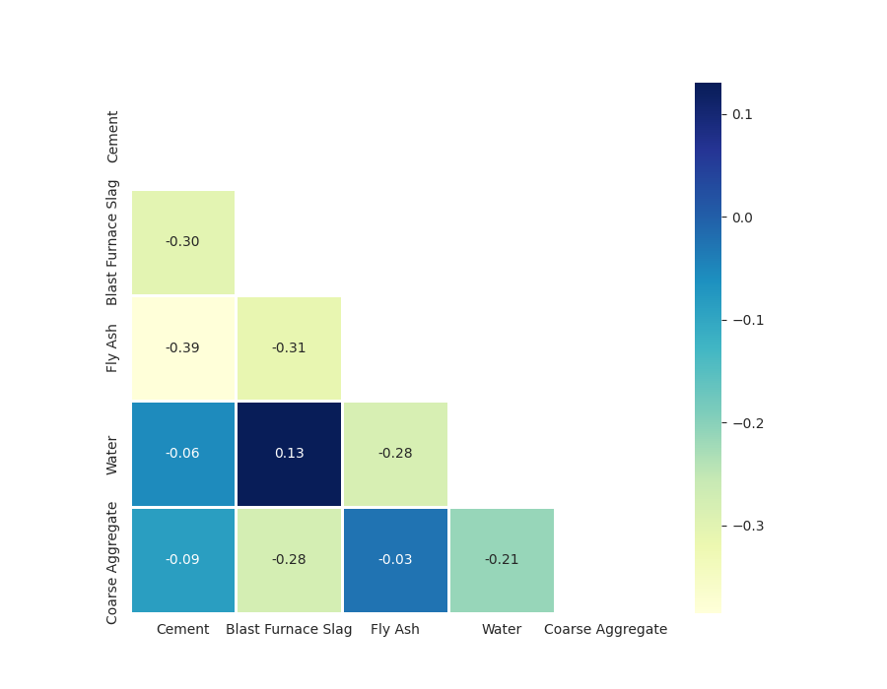

1. Multicollinearity- Correlation Matrix
We start with addressing multicollinearity issue, since it may involve dropping independent variable, which would affect later analysis.
As you can see from the graph, there are high correlations among
1. Superplasticizer and Fly Ash
2. Superplasticizer and Water
3. Water and Fine Aggregate
Notes:
Started by checking multicollinearity using correlation matrix.
The correlation matrix shows high correlations among superplasticizer & fly ash, superplasticizer & water, and water & fine aggregate.
So we decided to drop superplasticizer and fine aggregate from independent variables, and dropped age as well, since age is discrete and might not be helpful in our regression analysis.
This is the plot after dropping some independent variables, and there seems to be less multicollinearity issues.

Slide 14
1. Multicollinearity-
Confirm no multicollinearity issue exists using VIF
Features | VIF
Cement | 1.823
Blast Furnace Slag | 1.783
Fly Ash | 1.955
Water | 1.243
Coarse Aggregate | 1.330
Notes:
To be more sure, we computed Variance Inflation Factors for each independent variable.
All VIF value are less than 5, proving no multicollinearity issue exists.

Slide 15
1. Multicollinearity
2. Outlier Handling
3. Linearity
4. Homoscedasticity
5. Autocorrelation
6. Normality

Slide 16
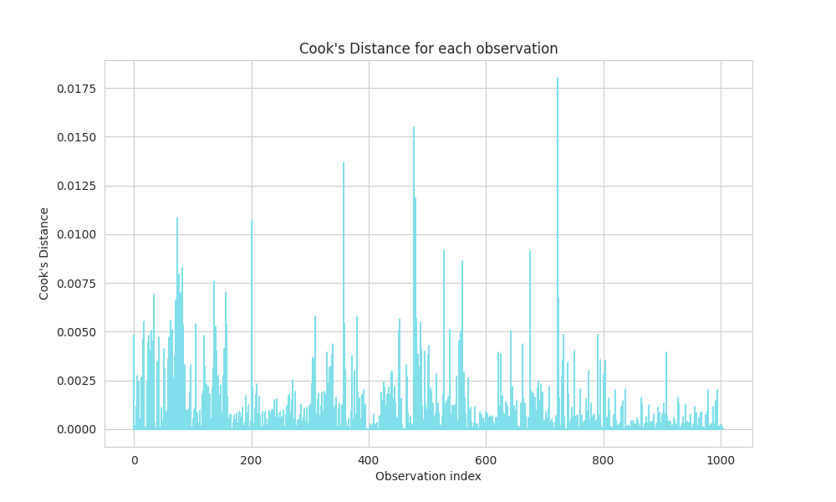
2. Outlier Handling - Cook’s Distance
Identify 63 outliers in total based on Cook’s distance, leaving us with 942 data points
Notes:
We used Cook’s distance to identify outliers from our dataset if any.
We were able to identify 63 outliers in total, and we removed them accordingly.

Slide 17
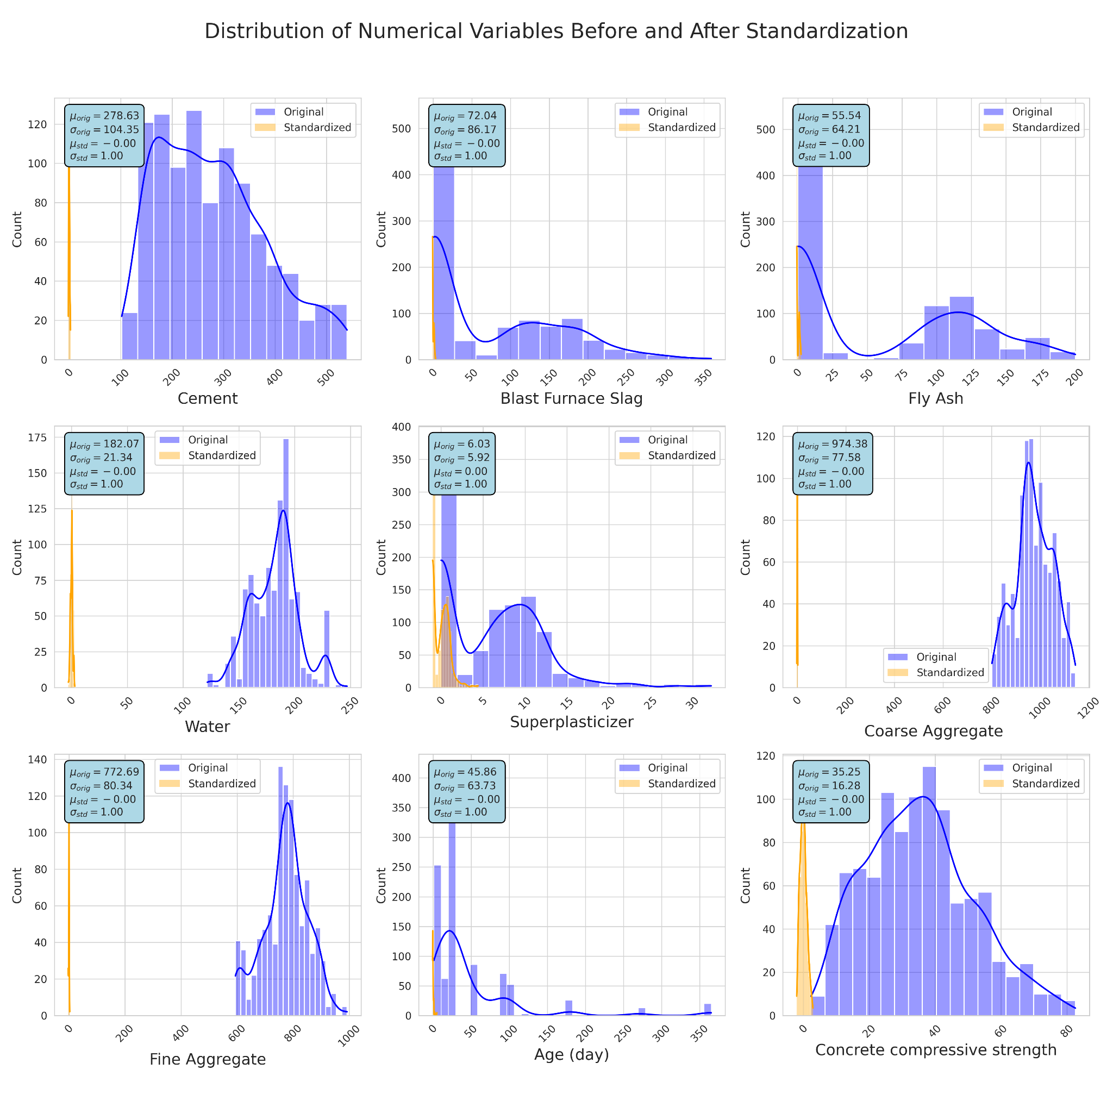
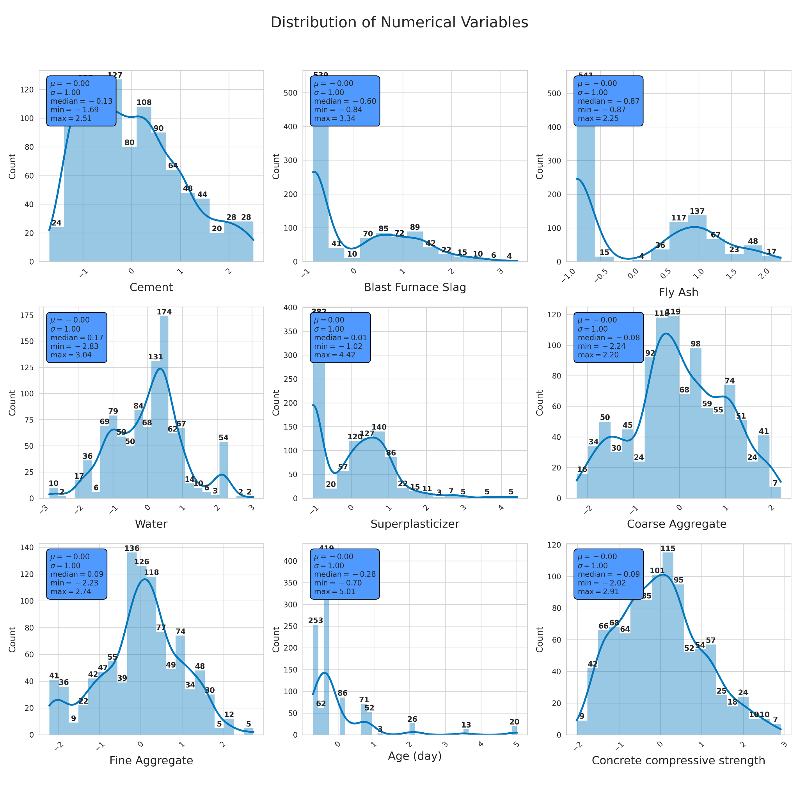
Apply Standardization
What we observed:
0 as center
Shape of the distribution is preserved
Min & Max changed
Notes:
We applied standardization after removing the outliers. Standardization preserves the shape of the distribution while shifting and scaling the data such that its mean is centered at 0 and the standard deviation is 1. The minimum and maximum values of each variables changed as well.
We tried running the model with and without removing outliers, and with and without standardizations, so 4 different models in total. But we had the best results with removing outliers and using standardization, so we are using that model in our presentation.

Slide 18
1. Multicollinearity
2. Outlier Handling
3. Linearity
4. Homoscedasticity
5. Autocorrelation
6. Normality

Slide 19
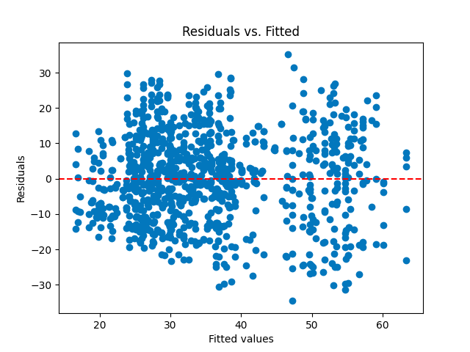
3. Linearity - Residuals Vs. Fitted Plot
There is no discernible pattern or trend in these plots, which is a good sign suggesting the relationship is linear
Notes:
To check linearity, we created two plots.
One of them is Residuals vs Fitted values plot.
As you can see, there is no obvious pattern in the plot, which suggests that there is no issue with linearity.

Slide 20
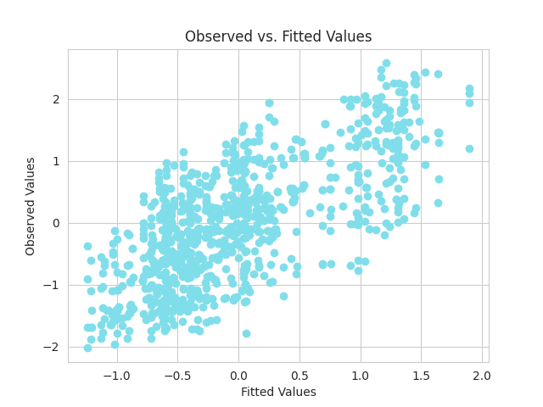
3. Linearity - Observed Vs. Fitted Plot
Points fall along the 45-degrees line, which suggest the model is a good fit
Notes:
Another plot we made is Observed values vs Fitted values plot.
It can be seen that the data points fall closely to the 45-degree line, which suggests there is a good fit, and no issue with linearity.

Slide 21
1. Multicollinearity
2. Outlier Handling
3. Linearity
4. Homoscedasticity
5. Autocorrelation
6. Normality

Slide 22


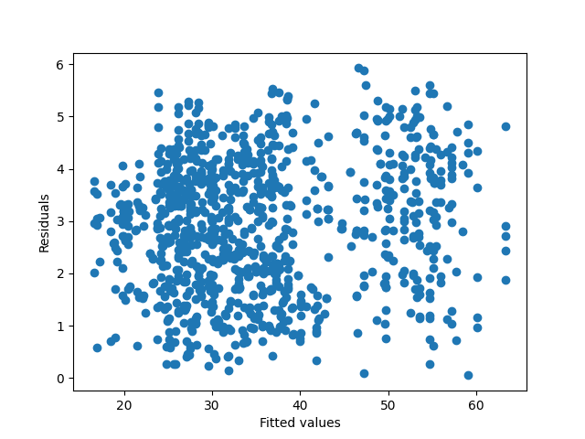

4. Homoscedasticity - Residual plots & Breusch-Pagan Test
H0: Homoscedasticity
H1: Heteroscedasticity
Statistic: 32.1832
p-value: 5.4650e-6
Strong evidence against Null hypothesis, suggest heteroscedasticity !!
WLS
Notes:
We used Breusch-Pagan test to check homoscedasticity.
Null hypothesis is that variance in a dataset is constant, which means homoscedasticity. Alternative hypothesis is heteroscedasticity.
As you can see, our p-value is very low, so our null hypothesis is rejected.
So at this stage, we could think of 2 solutions. First, transformation of variables, which we would try later after all diagnostic tests are done. Second is considering using Weighted Least Squares (WLS), which we kept in mind when selecting our model.

Slide 23
1. Multicollinearity
2.Outlier Handling
3. Linearity
4. Homoscedasticity
5. Autocorrelation
6. Normality

Slide 24
5. Autocorrelation - Durbin-Watson Test
H0: No Autocorrelation
H1: Autocorrelation
DW- Statistic: 1.4296
This DW statistics is below 2, which suggest there is positive autocorrelation
GLS
Notes:
We used Durbin-Watson test to check autocorrelation.
Null hypothesis is that there is no autocorrelation, and alternative hypothesis is that there is autocorrelation.
Our Durbin-Watson statistic showed below 2, and was relatively far apart from 2. This means that there is a positive autocorrelation.
Again, we could think of transforming our independent variables to fix this issue.

Slide 25
1. Multicollinearity
2. Outlier Handling
3. Linearity
4. Homoscedasticity
5. Autocorrelation
6. Normality

Slide 26

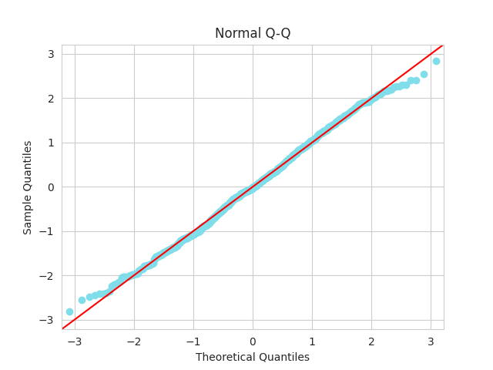
6. Normality -Normal Q-Q Plot & Jarque-Bera Test
Q-Q Plot
Jarque-Bera Test
H0: Errors are normally distributed
H1: Errors are not normally distributed.
p-value: 0.003066
Rejected!!
Try Variable Transformation
Notes:
To check normality, we plotted a Q-Q plot. It seemed rather okay, but when we tried Jarque-Bera test to ensure normality, our p-value was significantly low.
So our null hypothesis, which is that errors are normally distributed, was rejected.

Slide 27
*Transformation
Notes:
So we failed homoscedasticity, autocorrelation, and normality for our cross-sectional data. To fix this issue, we had to transform our independent variables.

Slide 28
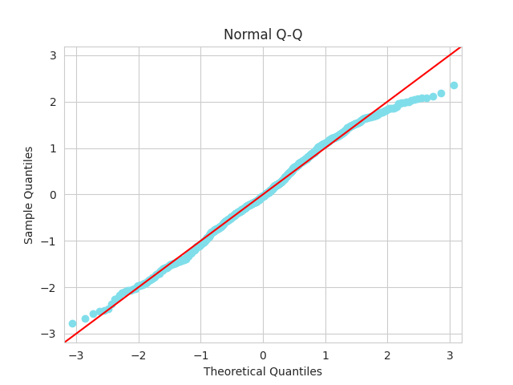
Box-Cox transformation
After transformation of variables
Q-Q plot (after)
P-value of Jarque-Bera drops a little bit
From 0.003 to 0.001
Normality Rejected
*we also check other statistics: linearity and autocorrelation improved but heteroscedasticity become worse
Notes:
We chose a box-cox transformation method to transform variables. Box-cox transformation is a statistical technique used to stabilize variance and make data more normally distributed. This is particularly useful when variables are not naturally distributed normally, causing issues like heteroscedasticity or skewness in statistical models. After transformation, however, p-value of Jarque-Bera test dropped even more, which did not fix normality issue. You can see that Q-Q plot shows the data points moving away from 45 degree line at the beginning and the end. Linearity and autocorrelation results improved, but heteroscedasticity became worse as well. Hence, it was concluded that box-cox transformation was not so helpful in this case.

Slide 29
1. Multicollinearity
2. Outlier Handling
3. Linearity
4. Homoscedasticity
5. Autocorrelation
6. Normality

Slide 30
Model Selection & Evaluation
03

Slide 31


Comparing Testing Statistics of All Models
 | VIF | BP test | DW test | JB test | RMSE | MAE | R-squared | Adjusted R-squared | AIC | BIC
OLS | No problem | 5.465e-6 | 1.4296 | 0.0031 | 0.6968 | 0.5680 | 0.5145 | 0.5119 | 2005 | 2034
WLS | No problem | 3.208e-5 | 1.4371 | 0.0015 | 0.6986 | 0.5727 | 0.4223 | 0.4192 | 2120 | 2149
GLS | No problem | 8.678e-7 | 1.4060 | 0.0065 | 0.6983 | 0.5653 | 0.4386 | 0.4356 | 1842 | 1872
LASSO | No problem | 0.0601 (Solved) | 1.8212 (Solved) | 0.1261 (Solved) | 0.7069 | 0.5803 | 0.4655 | 0.4559 | -470.6 | -443.6
Ridge | No problem | 0.0596 (Solved) | 1.8205 (Solved) | 0.1268 (Solved) | 0.7073 | 0.5805 | 0.4648 | 0.4552 | -470.6 | -443.7
Elastic Net | No problem | 0.0602 (Solved) | 1.8214 (Solved) | 0.1260 (Solved) | 0.7068 | 0.5802 | 0.4656 | 0.4560 | -470.6 | -443.6
Notes:
Penalized regressions have all the properties - normality, autocorrelation, and homoscedasticity - solved. And if we look at AIC and BIC value, penalized regression also have the lowest value, which indicate a lower model complexity.
Among penalized regressions, Elastic Net regression has the lowest RMSE and MAE, and the highest R-squared and adjusted R-squared. Lower RMSE and MAE indicate better predictive accuracy since they measure the difference between actual and predicted values. Higher R-squared and adjusted R-squared indicate that more variance in the dependent variable is explained by the model. So we decided that Elastic Net regression is the best model for our cross-sectional data.

Slide 32
Time Series
Analysis
Part 2

Slide 33

Time Series Analysis: Background
In time series part, we mainly focus on analyzing what variables may affect unemployment rate.
Analyzing unemployment is crucial for understanding economic health, informing policy decisions, and devising strategies to mitigate its social and economic impacts.

Slide 34
Time Series Analysis: Setup
Things that we want to figure out through data analysis…
Independent Variables:
S&P500
Federal Funds Effective Rate
Average Egg Price
Global Price of Aluminium
Global Price of Olive Oil
Global Price of Energy Index
10-Year Expected Inflation
Average Electric Price per KWh
Dependent Variable:
Monthly Unemployment Rate
Which factors affect monthly unemployment rate the most?
Notes:
Mention that we temporarily include all variables, and we will show variable elimination process

Slide 35
Time Series Analysis: Outline
01
02
Exploratory Data Analysis
Diagnostic Tests
Numerical Distribution, Box Plot,
Time Series Plot, Scatter Plot
Multicollinearity, Linearity, Normality, Auto-correlation, Homoscedasticity,
03
04
Model Selection & Evaluation
Back Testing
WLS, GLS and Penalized Regression
Predictive Power Test

Slide 36
Exploratory Data Analysis
01

Slide 37
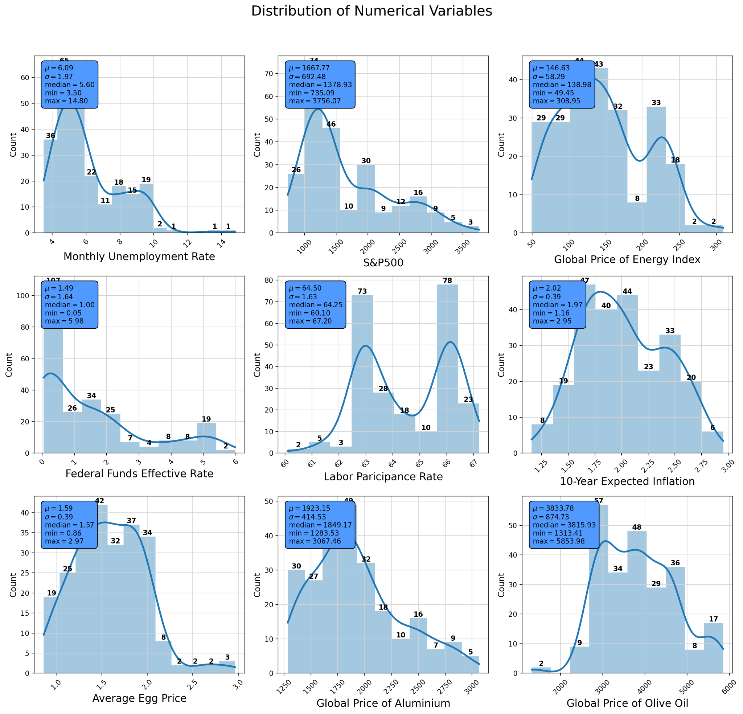
Get a feel for Data Distributions
Problems we may encounter:
Outlier
Skewness of data
→ Transformation of variable

Slide 38
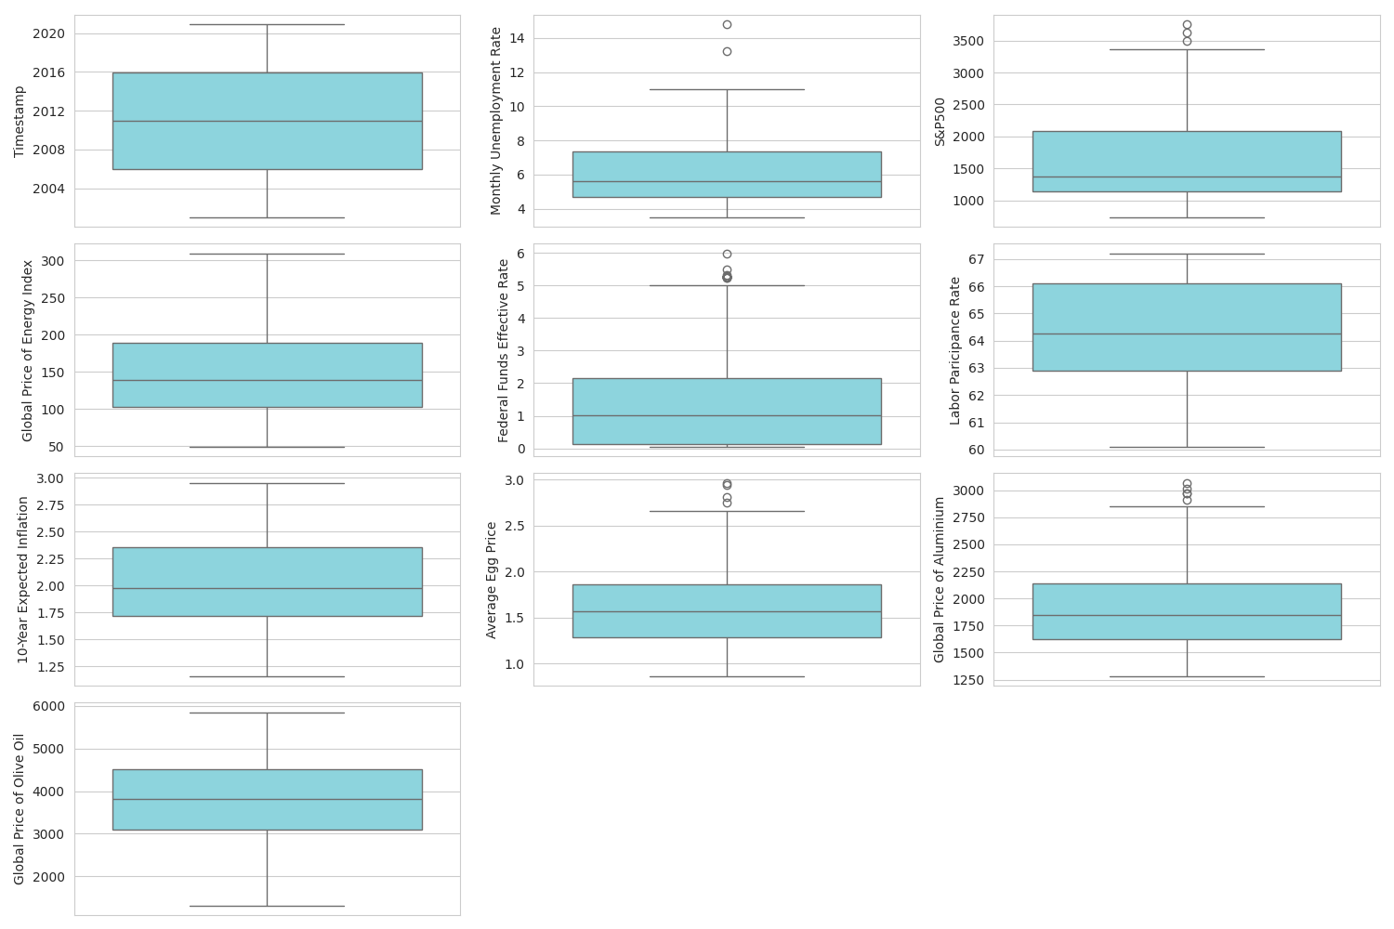
Identify Potential Outliers using Boxplot
Same as in before, some outliers are identified in the box plot.
Since our dataset of Time series data is relatively small (240 data points)
We expect removing outlier would have greater influence on our model

Slide 39
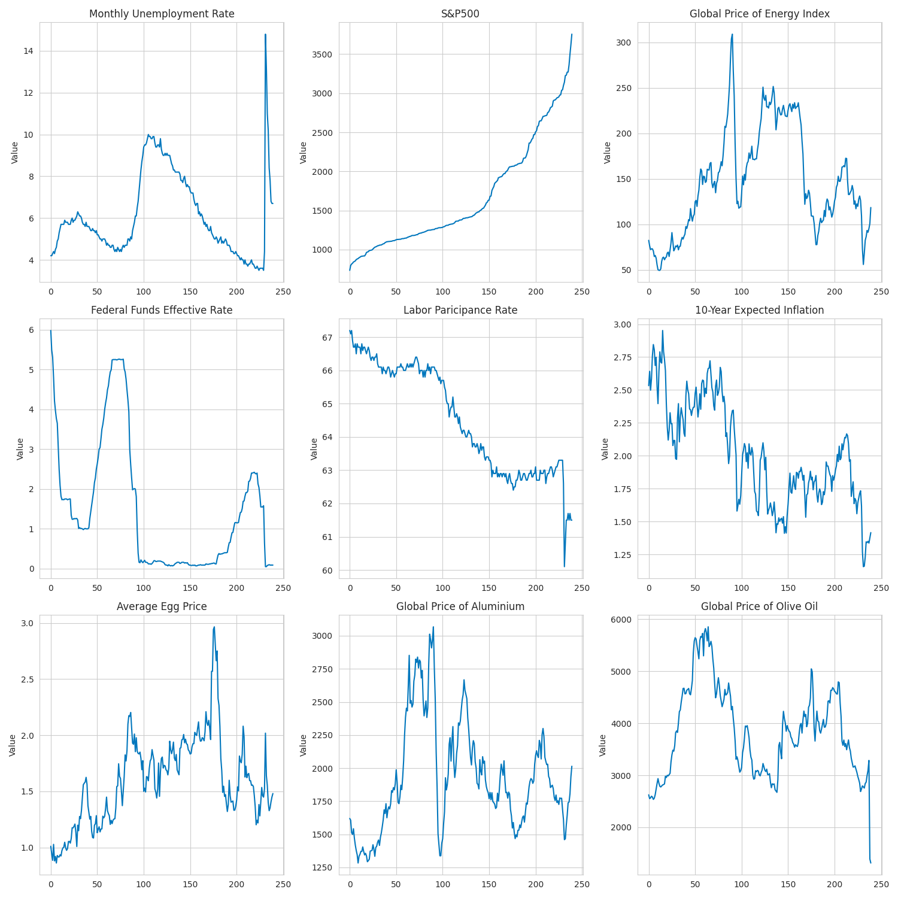
A Glance of Data: Time Series Plot
Problems we may encounter:
Multicollinearity: some of the predictors seem to be correlated from the time series plot

Slide 40
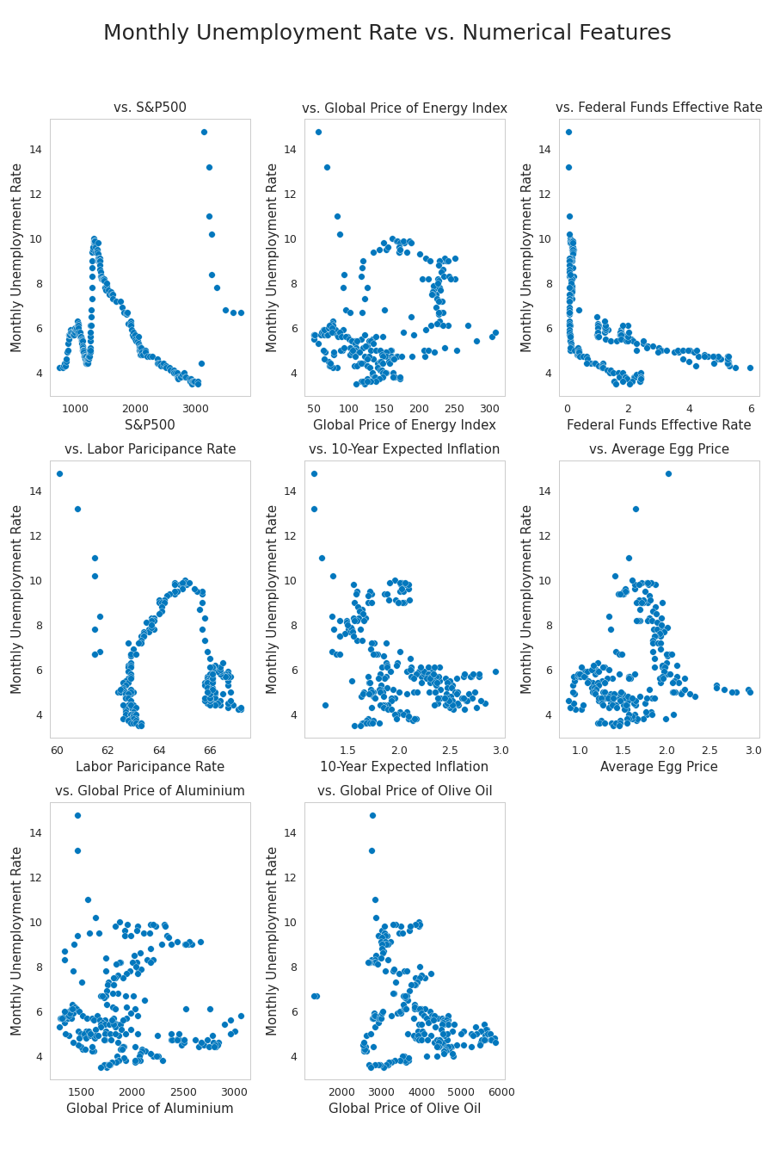
Check for Linearity between variables using Scatter plot
All Scatter plots show a lot of dispersion and do not display a clear linear trend
May suggest Linearity issue
Further analysis and tests needed!

Slide 41
Diagnostic tests
02
Notes:
To explore more “issues” with the data set:
We need to perform diagnostic tests on the data set before we select a regression model

Slide 42
1. Multicollinearity
2. Outlier Handling
3. Linearity
4. Homoscedasticity
5. Autocorrelation
6. Normality

Slide 43
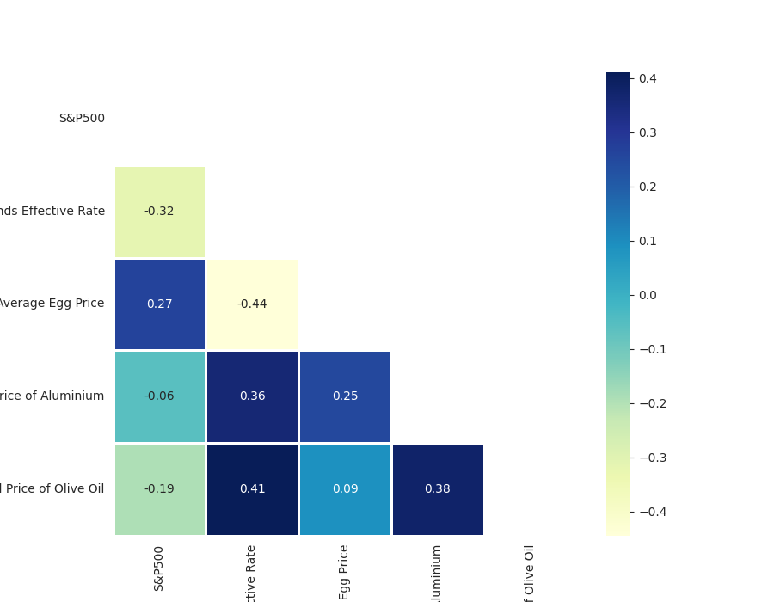
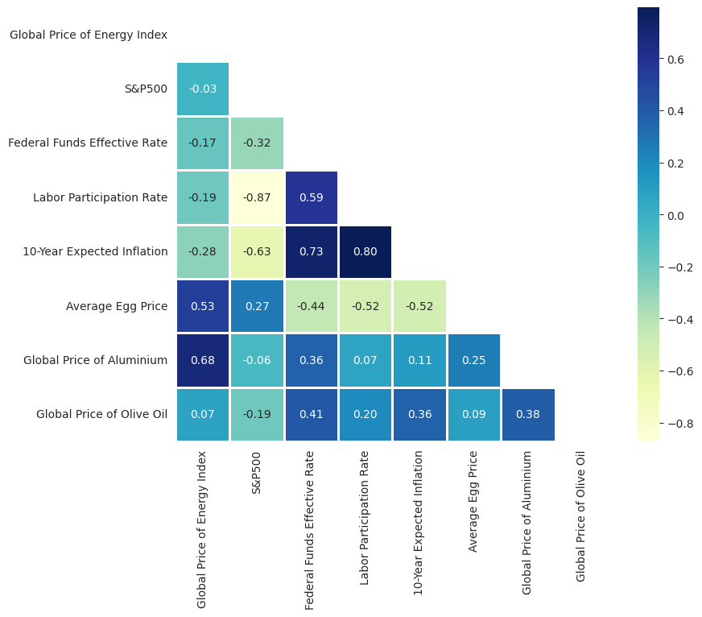
1. Multicollinearity- Correlation Matrix
As you can see from the graph, there are high correlations among
1. 10-Year Expected Inflation and Labor Participation and Federal Funds Effective Rate
2. Global Price of Energy Index and Global Price of Aluminium
Notes:
Started by checking multicollinearity using correlation matrix.
The correlation matrix shows high correlations among 10-year expected inflation & labor participation & federal funds effective rate, and between global price of energy index and global price of aluminium.
So we decided to drop 10-year expected inflation, labor participation and global price of energy index from independent variables.
This is the plot after dropping some independent variables, and there seems to be less multicollinearity issues.

Slide 44
1. Multicollinearity-
Confirm no multicollinearity issue exist using VIF
Features | VIF
S&P500 | 1.156
Federal Funds Effective Rate | 2.125
Average Egg Price | 1.796
Global Price of Aluminum | 1.547
Global Price of Olive Oil | 1.399
Notes:
To be more sure, we computed Variance Inflation Factors for each independent variable.
All VIF value are less than 5, proving no multicollinearity issue exists.

Slide 45
1. Multicollinearity
2. Outlier Handling
3. Linearity
4. Homoscedasticity
5. Autocorrelation
6. Normality

Slide 46
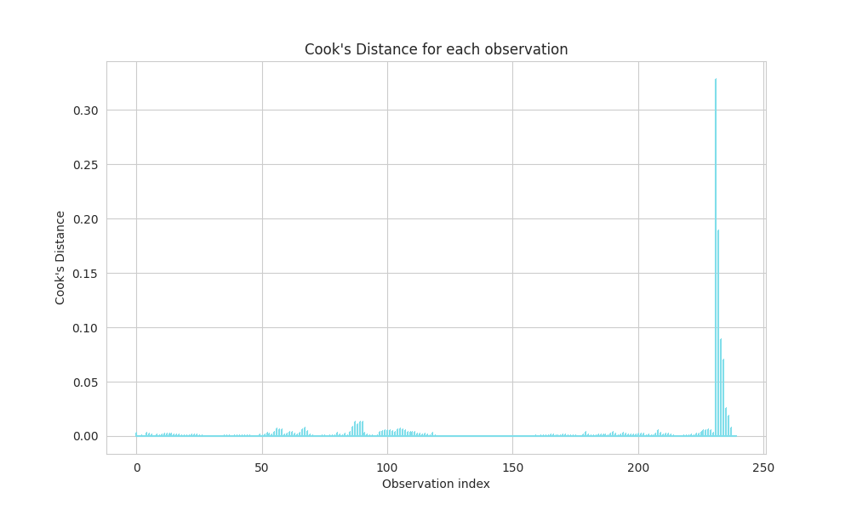
2. Outlier Handling - Cook’s Distance
Different from before, the outliers here are more extreme
Identify 6 outliers in total based on Cook’s distance, leaving us with 234 data points
Notes:
We used Cook’s distance to identify outliers from our dataset if any.
We were able to identify 6 outliers in total, and we removed them accordingly.
This time, the outliers were very far off compared to cross-sectional data, so removing outliers would have significantly improved our diagnostic tests results.

Slide 47
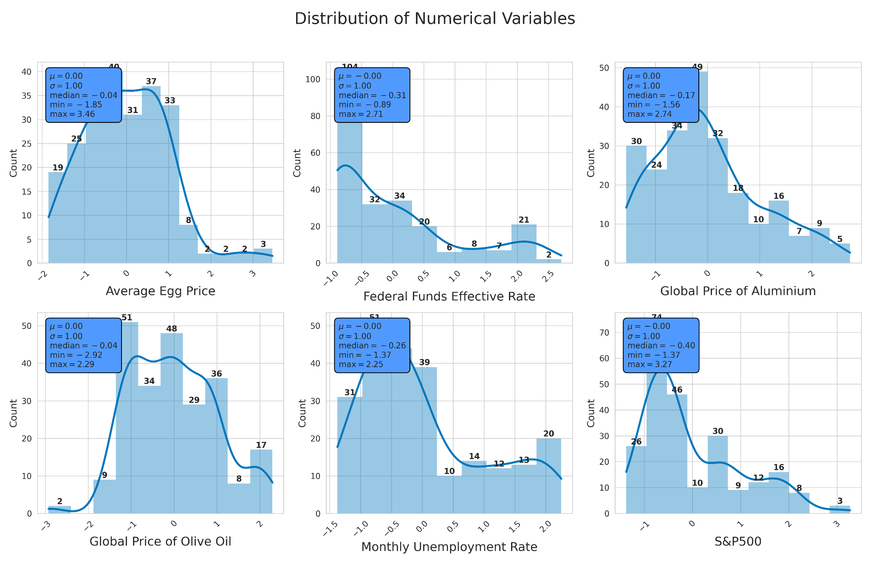
Apply Standardization
Same as before:
0 as center
Shape of the distribution is preserved
Min & Max changed
Notes:
We applied standardization after removing the outliers. Standardization preserves the shape of the distribution while shifting and scaling the data such that its mean is centered at 0 and the standard deviation is 1. The minimum and maximum values of each variables changed as well.
We tried running the model with and without removing outliers, and with and without standardizations, so 4 different models in total. But we had the best results with removing outliers and using standardization, so we are using that model in our presentation.

Slide 48
1. Multicollinearity
2. Outlier Handling
3. Linearity
4. Homoscedasticity
5. Autocorrelation
6. Normality

Slide 49
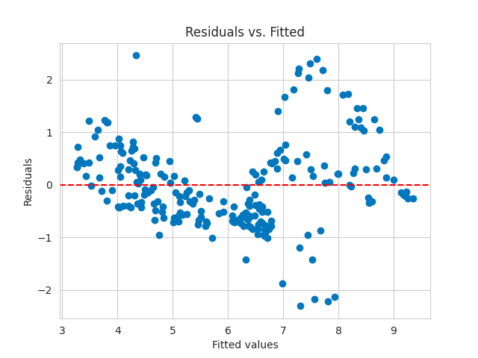
3. Linearity -Residuals Vs. Fitted Plot
There is some discernible pattern in this plots, which might suggest the relationship is not linear
Try Variable Transformation
Notes:
To check linearity, we created two plots.
One of them is Residuals vs Fitted values plot.
You can see some patterns in the plot, which indicates that the relationship might not be linear.
To fix this issue, we could try variable transformation later.

Slide 50
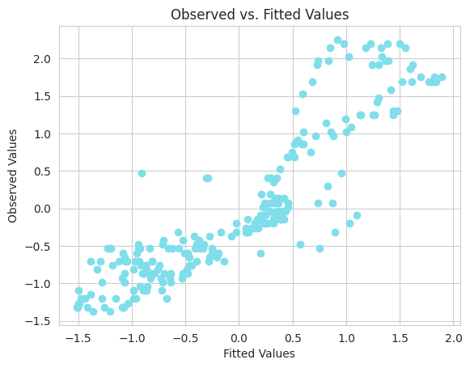
3. Linearity - Observed Vs. Fitted Plot
Points are pretty scattered from the 45-degrees line, which suggest the model is not a good fit
Notes:
Another plot we made is Observed values vs Fitted values plot.
It can be seen that the data points scatter way from the 45-degree line, which suggests there is not a good fit.

Slide 51
1. Multicollinearity
2. Outlier Handling
3. Linearity
4. Homoscedasticity
5. Autocorrelation
6. Normality

Slide 52
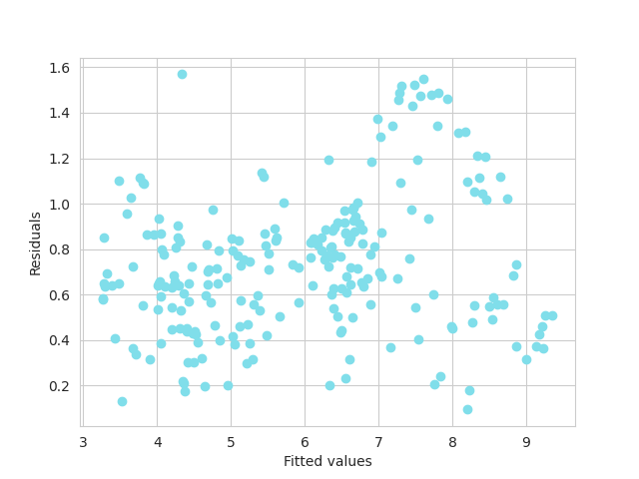
4. Homoscedasticity - Residual plots & Breusch-Pagan Test
H0: Homoscedasticity
H1: Heteroscedasticity
Statistic: 22.5356
p-value: 0.000414
Strong evidence against Null hypothesis, suggest heteroscedasticity !!
WLS
Notes:
We used Breusch-Pagan test to check homoscedasticity.
Null hypothesis is that variance in a dataset is constant, which means homoscedasticity. Alternative hypothesis is heteroscedasticity.
As you can see, our p-value is very low, lower than 0.05, so our null hypothesis is rejected.
So at this stage, we could think of 2 solutions. First, transformation of variables, which we would try later after all diagnostic tests are done. Second is considering using Weighted Least Squares (WLS), which we kept in mind when selecting our model.

Slide 53
1. Multicollinearity
2. Outlier Handling
3. Linearity
4. Homoscedasticity
5. Autocorrelation
6. Normality

Slide 54
5. Autocorrelation - Durbin-Watson Test
H0: No Autocorrelation
H1: Autocorrelation
DW- Statistic: 0.156114
This DW statistics is EXTREMELY below 2, which suggest there is strong positive autocorrelation
GLS
KEY OBSERVATIONS – Autocorrelation issue is much serve in time series data compared to cross-sectional data where DW- statistics = 1.4296
Notes:
We used Durbin-Watson test to check autocorrelation.
Null hypothesis is that there is no autocorrelation, and alternative hypothesis is that there is autocorrelation.
Our Durbin-Watson statistic showed below 2, and was significantly far apart from 2. This means that there is a strong positive autocorrelation.
Compared to cross-sectional data, autocorrelation issue in time series data is much worse.
Again, we could think of transforming our independent variables or using GLS to fix this issue.

Slide 55
1. Multicollinearity
2. Outlier Handling
3. Linearity
4. Homoscedasticity
5. Autocorrelation
6. Normality

Slide 56
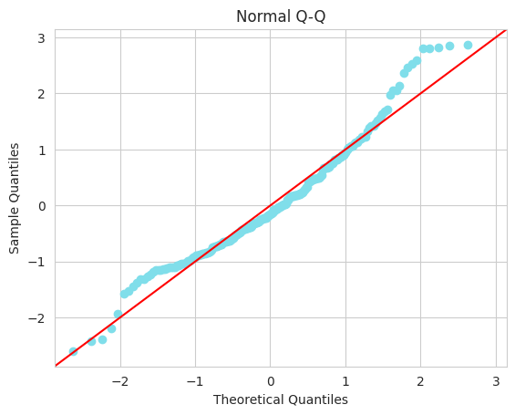
6. Normality -Normal Q-Q Plot & Jarque-Bera Test
Q-Q Plot
Jarque-Bera Test
H0: Errors are normally distributed
H1: Errors are not normally distributed.
p-value: 0.0001
Rejected!!
Try Variable Transformation
Notes:
To check normality, we plotted a Q-Q plot. It does not seem to be following the 45 degree line, especially at the beginning and the end of the graph.
So when we tried Jarque-Bera test, our p-value was significantly low.
So our null hypothesis, which is that errors are normally distributed, was rejected.

Slide 57
*Transformation

Slide 58
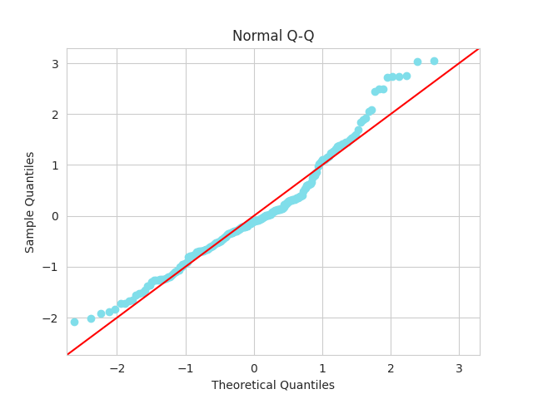

Box-Cox transformation
Q-Q plot (after)
After transformation of variables
P-value of Jarque-Bera decreased
From 0.0001 to 5.745e-6
Normality is Still Rejected
*we also check other statistics: heteroskedasticity and autocorrelation improved but linearity become worse
KEY OBSERVATIONS – Autocorrelation issues for both datasets improved after transformation of variables
Notes:
After box-cox transformation, p-value of Jarque-Bera test dropped even more again, which did not fix normality issue. You can see that Q-Q plot shows the data points moving away from 45 degree line at the beginning and the end. Heteroscedasticity and autocorrelation results improved, but linearity became worse as well. Hence, it was concluded that box-cox transformation was not so helpful in this case again.

Slide 59

Why Transformation does not always work.
Our Guesses:
Gives Partial Correction
Non-Stationarity in Time Series
Complex Relationships
In both cross-sectional and time series data, we see that transformations improve one issue while worsening another.
Time series data: autocorrelation and non-stationarity
– simple transformations might not be able to eliminate those issues, especially if seasonality or trend components are strong.
Data with complex underlying patterns or extreme non-linearity may not be adequately addressed by this transformation alone.
Notes:
We tried to guess why this transformation method we tried did not work. When one issue is improved, another issue gets worse. Especially for time series data, due to its non-stationarity, simple transformations might not fix these issues. If seasonality or trend components are too strong, transformation will not have much effect. Also, data with complex patterns or extreme non-linearity might require more methods of transformation, instead of just one simple transformation method.

Slide 60
1. Multicollinearity
2. Outlier Handling
3. Linearity
4. Homoscedasticity
5. Autocorrelation
6. Normality

Slide 61
Model Selection & Evaluation
03

Slide 62
Comparing Statistics of All Models
 | VIF | BP test | DW test | JB test | RMSE | MAE | R-squared | Adjusted R-squared | AIC | BIC
OLS | No problem | 0.0004 | 0.156 | 0.0001 | 0.457 | 0.352 | 0.791 | 0.787 | 309.3 | 330.0
WLS | No problem | 0.0005 | 0.303 | 1.18e-08 | 0.457 | 0.349 | 0.998 | 0.998 | 10.1 | 30.83
GLS | No problem | 0.0001 | 0.524 | 6.37e-27 | 0.460 | 0.361 | 0.737 | 0.732 | 47.9 | 68.83
LASSO | No problem | 0.0004 | 0.156 | 0.0001 | 0.457 | 0.352 | 0.791 | 0.786 | -354.8 | -334.1
Ridge | No problem | 0.0003 | 0.155 | 6.35e-05 | 0.457 | 0.352 | 0.791 | 0.7859 | -354.8 | -334.0
Elastic Net | No problem | 0.0002 | 0.148 | 8.74e-06 | 0.458 | 0.351 | 0.790 | 0.785 | -353.7 | -332.9

Slide 63
Back Testing - Predictive Power Test
04

Slide 64


Time Series Analysis: Backtesting
 | RMSE | MAE | R-squared | Adjusted R-squared
OLS | 0.653 | 0.602 | -8.189 | -11.497
WLS | 0.652 | 0.600 | -7.847 | -11.037
GLS | 0.470 | 0.374 | 0.771 | 0.737
LASSO | 0.465 | 0.362 | 0.775 | 0.747
Ridge | 0.465 | 0.361 | 0.775 | 0.748
Elastic Net | 0.466 | 0.362 | 0.775 | 0.747
We use cross-validation to split the data into different folds and compute the average statistics across all folds, as shown in the table on the left
It is interesting to observe that GLS and penalized models
perform equally well and the performance of OLS and WLS dropped significantly in the backtesting
However, if to compare model complexity, penalized regression would generally have lower AIC & BIC
And since Lasso has relatively high p-value in JB-test
We would announce Lasso as winner!!

Slide 65
Summary
Part 3

Slide 66
WLS and GLS are targeted to fix heteroskedasticity and autocorrelation , we notice that, in practice, it is generally hard to find appropriate weights and covariance matrices which might thus hinders their benefits
Implemented LASSO, Ridge, and Elastic Net
Addressed overfitting and multicollinearity
Proven good generalizability as we seen in cross sectional analysis
In cross sectional analysis, penalized models successfully pass all tests!
Efficiency and Unbiasedness
Utilized OLS
Adopted WLS and GLS models
Generally hard to satisfy all properties
Used different statistics to evaluate model performance
Balance accuracy and complexity
BLUE
Properties
Penalized Regression
Model Evaluation
AIC & BIC – also confirm Penalized regression as the best model in both data!
In cross sectional analysis: only satisfy 2 of them
In time series analysis : only satisfy multicollinearity
What We learned
Analyze data collected at a single point in time
Used different diagnostic tests
Cross Sectional
Time Series
Comparison
between Cross sectional and Time series
Severe Autocorrelation issue in time series data
Generally harder to satisfy BLUE properties in time series data
Analyze data collected over time
Backtesting
Non-stationary
Even with the help of Penalized model, time series data still fail most of the diagnostic tests
Notes:
At the beginning of the class, we learned BLUE properties and also how those assumptions help achieve “ the unbiased linear estimator that has the minimum variance “ as well as the mathematical proof. Then, we learn about OLS, WLS, GLS. While ……, we notice that… . Both model assume that the model assumptions is correctly specified, Mis-specification can lead to incorrect conclusions, similar to the issues faced with misspecified OLS models.
Then we are introduced to the penalized regression, turn out to perform well in practice. Especially in scenarios where a simpler model is likely to outperform a more complex one due to the high dimensionality or noisy data (reduce data dimension and model complexity)
We turn theory into pratice by applying those techniques to cross sectional and time series analysis.
Overall, we are exposed to the entire pipeline of regression project, starting from exploratory data analysis, then do feature scaling (normalization and standardization), apply diagnosis test, finally come to conclusion by model evaluation and backtesting.

Slide 67

Thanks!!
Notes:
Thank you all for listening to our presentation!

